Slide 1
Vertical and Horizontal
Transformations of Linear Functions
Algebra I | Module 2 | Topic 2 | Lesson 2
1
Notes:
Note: Total suggested pacing for this lesson is two 45-minute sessions.

Slide 2
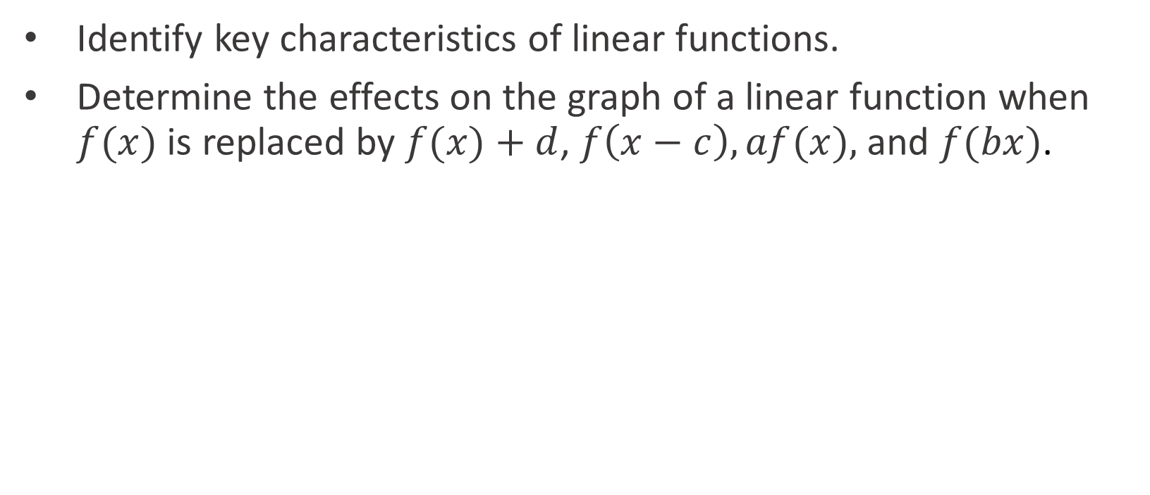
Objectives
Identify key characteristics of linear functions.
Determine the effects on the graph of a linear function when $f(x)$ is replaced by $f(x)+d$, $f\left(x−c\right), af(x),$ and $f(bx)$.
SE p. 287
2
Notes:
TEKS:
A.1F: analyze mathematical relationships to connect and communicate mathematical ideas.
A.1G: display, explain, and justify mathematical ideas and arguments using precise mathematical language in written or oral communication.
A.2A: determine the domain and range of a linear function in mathematical problems; determine reasonable domain and range values for real-world situations, both continuous and discrete; and represent domain and range using inequalities.
A.2C: write linear equations in two variables given a table of values, a graph, and a verbal description.
A.3C: graph linear functions on the coordinate plane and identify key features, including x-intercept, y-intercept, zeros, and slope, in mathematical and real-world problems.
A.3E: determine the effects on the graph of the parent function f(x) = x when f(x) is replaced by af(x), f(x) + d, f(x − c), f(bx) for specific values of a, b, c, and d.
ELPS:
1.E: internalize new basic and academic language by using and reusing it in meaningful ways in speaking and writing activities that build concept and language attainment.
2.D: monitor understanding of spoken language during classroom instruction and interactions and seek clarification as needed.
3.C: speak using a variety of grammatical structures, sentence lengths, sentence types, and connecting words with increasing accuracy and ease as more English is acquired.

Slide 3
Essential Question (1 of 2)
You have learned about the effects of vertical transformations on linear functions.
What effect do horizontal transformations have on linear functions? How do they compare to vertical transformations?
SE p. 287
3
Notes:
Setting the Stage:
Tap into your student’s prior learning by reading the narrative statement.
Provide a sense of direction by reading the Essential Question.

Slide 4
Day 1
1
4
Notes:
Note: Total suggested pacing for Day 1 is 45 minutes.

Slide 5
Getting Started
★ Essential activity: do not skip
5–10
5
Notes:
Note: Total time of 5-10 minutes allotted for the Getting Started.

Slide 6
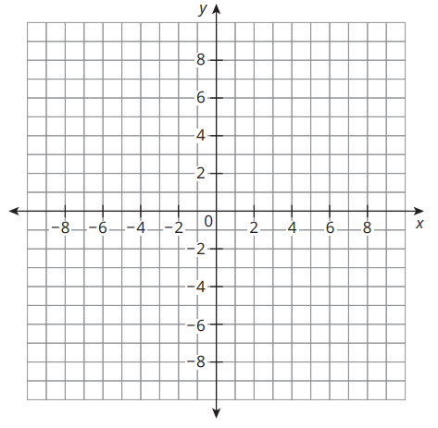
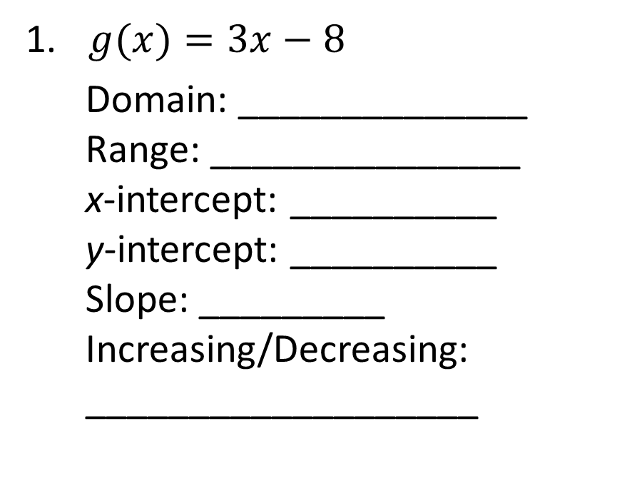
Hey, I Remember This! (1 of 4)
Graph each linear function and describe the key characteristics of the graph.
$g(x)=3x−8$
Domain: ______________
Range: _______________
x-intercept: __________
y-intercept: __________
Slope: _________
Increasing/Decreasing:
___________________
Graph g(x): through (0, −8) and (3, 1)
Domain:
all real numbers
(8/3, 0)
(0, −8)
Range:
all real numbers
3
Increasing
★ Essential · SE p. 288
6
Notes:
Questions to Support Discourse – Gathering:
Are the domain and range of g(x) the same as h(x)?
How do you determine the x-intercept/zero?
How do you determine the y-intercept?
How do you determine the slope?
How do you determine whether the function is increasing or decreasing?

Slide 7
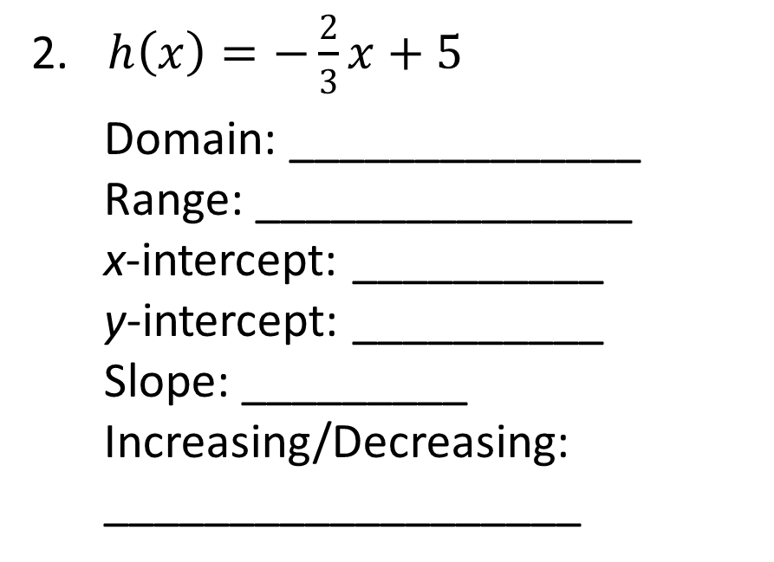
Hey, I Remember This! (2 of 4)
$h\left(x\right)=−\frac{2}{3}x+5$
Domain: ______________
Range: _______________
x-intercept: __________
y-intercept: __________
Slope: _________
Increasing/Decreasing:
___________________
Graph h(x): through (0, 5) and (3, 3)
Domain:
all real numbers
(7.5, 0)
Range:
all real numbers
(0, 5)
−2/3
Decreasing
★ Essential · SE p. 288
7
Notes:
Questions to Support Discourse – Gathering:
Are the domain and range of g(x) the same as h(x)?
How do you determine the x-intercept/zero?
How do you determine the y-intercept?
How do you determine the slope?
How do you determine whether the function is increasing or decreasing?

Slide 8

Hey, I Remember This! (3 of 4)
Let’s summarize our learning from the Getting Started!
★ Essential · SE p. 288
8
Notes:
Getting Started Summary:
The graph and key characteristics of a linear function can be determined from the equation.

Slide 9
Hey, I Remember This! (4 of 4)
★ Essential · SE p. 288
9
Notes:
Note: This slide is blank for optional use with displaying work.

Slide 10
Activity 2.1
★ Essential activity: do not skip
2.1
30–35
10
Notes:
Note: Total time of 30-35 minutes allotted for Activity 2.1.

Slide 11

Comparing Vertical and Horizontal Translations (1 of 17)
Let’s determine how translations impact the graph of the linear function f(x) = x.
You can translate the graph of f(x) to the right 5 units by moving each point 5 units to the right. The transformed graph is labeled as m(x).
To translate the point (−2, −2) on f(x), add 5 units to the input value, or x-value. The output value, or y-value, remains unchanged.
The coordinates of the translated point on m(x) are (3, −2).
The coordinates of four additional points on f(x) are translated for you.
★ Essential · SE p. 289
11

Slide 12
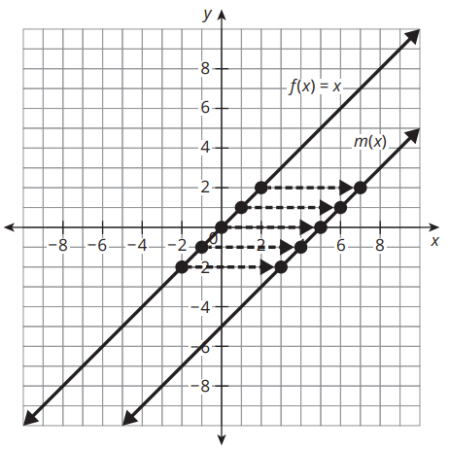
Comparing Vertical and Horizontal Translations (2 of 17)
Original Graph
Transformed Graph
x | f(x)
−2 | −2
−1 | −1
0 | 0
1 | 1
2 | 2
x | m(x)
3 | −2
4 | −1
5 | 0
6 | 1
7 | 2
★ Essential · SE p. 289
12

Slide 13
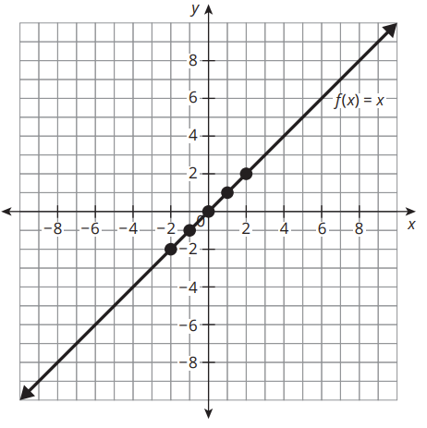
Comparing Vertical and Horizontal Translations (3 of 17)
Given the graph and a table of values for f(x) = x, complete the following transformations.
  Translate the graph of f(x) left 3 units. Label your graph as t(x). Complete the table of corresponding points on t(x).
Original Graph
Transformed Graph
x | f(x)
−2 | −2
−1 | −1
0 | 0
1 | 1
2 | 2
x | t(x)
−5
−2
Graph t(x): through (−3, 0) and (0, 3)
−4
−1
−3
0
−2
1
−1
2
★ Essential · SE p. 290
13
Notes:
Questions to Support Discourse – Probing:
Do horizontal translations of f(x), such as m(x) and t(x), affect the domain?
Do horizontal translations of f(x) affect the input values of the translated function?
Do vertical translations of f(x) affect the output values of the translated function?
For the parent function f(x), is a horizontal translation right 5 units equivalent to a vertical translation down 5 units?
For the parent function f(x), is a vertical translation up 3 units equivalent to a horizontal translation left 3 units?

Slide 14
Comparing Vertical and Horizontal Translations (4 of 17)
  Translate the graph of f(x) up 3 units. Label your graph as w(x). Complete the table of corresponding points on w(x).
Graph w(x): through (0, 3) and (−3, 0). It is the same line as t(x).
Original Graph
Transformed Graph
x | f(x)
−2 | −2
−1 | −1
0 | 0
1 | 1
2 | 2
x | w(x)
−2
1
−1
2
Ask Yourself…
What observations can you make?
0
3
1
4
2
5
★ Essential · SE p. 290
14
Notes:
Questions to Support Discourse – Probing:
Do horizontal translations of f(x), such as m(x) and t(x), affect the domain?
Do horizontal translations of f(x) affect the input values of the translated function?
Do vertical translations of f(x) affect the output values of the translated function?
For the parent function f(x), is a horizontal translation right 5 units equivalent to a vertical translation down 5 units?
For the parent function f(x), is a vertical translation up 3 units equivalent to a horizontal translation left 3 units?

Slide 15
Comparing Vertical and Horizontal Translations (5 of 17)
  Compare the table of values for f(x) and t(x). Are the input values or output values affected by this horizontal translation?
  Compare the table of values for f(x) and w(x). Are the input values or output values affected by this vertical translation?
  Compare the graphs and tables of values for t(x) and w(x). What do you notice?
The input values. The output values stay the same.
The output values. The input values stay the same.
The graphs of t(x) and w(x) are the same line, y = x + 3, but their tables of values are different.
★ Essential · SE p. 291
15
Notes:
Questions to Support Discourse – Probing:
Do horizontal translations of f(x), such as m(x) and t(x), affect the domain?
Do horizontal translations of f(x) affect the input values of the translated function?
Do vertical translations of f(x) affect the output values of the translated function?
For the parent function f(x), is a horizontal translation right 5 units equivalent to a vertical translation down 5 units?
For the parent function f(x), is a vertical translation up 3 units equivalent to a horizontal translation left 3 units?

Slide 16
Comparing Vertical and Horizontal Translations (6 of 17)
  Which transformation(s) of the parent function f(x) = x affect the input values of the corresponding points on the transformed function?
  Which transformation(s) of the parent function f(x) = x affect the output values of the corresponding points on the transformed function?
Horizontal translations, y = f(x − c). The output values of the corresponding points stay the same.
Vertical translations, y = f(x) + d. The input values of the corresponding points stay the same.
★ Essential · SE p. 291
16
Notes:
Questions to Support Discourse – Probing:
Do horizontal translations of f(x), such as m(x) and t(x), affect the domain?
Do horizontal translations of f(x) affect the input values of the translated function?
Do vertical translations of f(x) affect the output values of the translated function?
For the parent function f(x), is a horizontal translation right 5 units equivalent to a vertical translation down 5 units?
For the parent function f(x), is a vertical translation up 3 units equivalent to a horizontal translation left 3 units?

Slide 17
Comparing Vertical and Horizontal Translations (7 of 17)
  Based on your observations, horizontally translating the parent function f(x) = x right n units is equivalent to what other transformation?
  Based on your observations, vertically translating the parent function f(x) = x up n units is equivalent to what other transformation?
A vertical translation down n units.
A horizontal translation left n units.
★ Essential · SE p. 291
17
Notes:
Questions to Support Discourse – Probing:
Do horizontal translations of f(x), such as m(x) and t(x), affect the domain?
Do horizontal translations of f(x) affect the input values of the translated function?
Do vertical translations of f(x) affect the output values of the translated function?
For the parent function f(x), is a horizontal translation right 5 units equivalent to a vertical translation down 5 units?
For the parent function f(x), is a vertical translation up 3 units equivalent to a horizontal translation left 3 units?

Slide 18
Comparing Vertical and Horizontal Translations (8 of 17)
  For the parent function f(x) = x, the transformed function y = f(x − c) affects the input values, or x-values, of the function. For c > 0, the resulting graph horizontally shifts right c units. For c < 0, the resulting graph horizontally shifts left c units.
  For the parent function f(x) = x, the transformed function y = f(x) + d affects the output values, or y-values, of the function. For d > 0, the resulting graph vertically shifts up d units. For d < 0, the resulting graph vertically shifts down d units.
★ Essential · SE p. 292
18

Slide 19
Comparing Vertical and Horizontal Translations (9 of 17)
  You have determined that for the parent function f(x) = x, a horizontal translation right n units produces the same graph as a vertical translation down n units. In addition, a horizontal translation left n units produces the same graph as a vertical translation up n units.
  Let’s see whether these translations have similar effects on the graph of any linear function.
★ Essential · SE p. 292
19

Slide 20
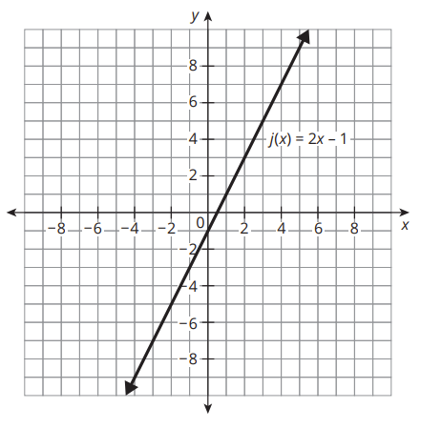
Comparing Vertical and Horizontal Translations (10 of 17)
  Consider the graph of j(x) = 2x − 1.
    Sketch the graph of j(x) shifted up 4 units. Label the graph as q(x).
    Write an equation for q(x) in terms of j(x).
    Sketch the graph of j(x) shifted left 4 units. Label the graph as r(x).
    Write an equation for r(x) in
    terms of j(x).
r(x) = j(x + 4)
q(x) = j(x) + 4
a. Graph q(x): through (0, 3), slope 2
c. Graph r(x): through (0, 7), slope 2
★ Essential · SE p. 292
20
Notes:
Questions to Support Discourse – Seeing Structure:
Is q(x) written as q(x) = j(x) + 4 or written as q(x) = j(x + 4)?
Is r(x) written as r(x) = j(x) + 4 or written as r(x) = j(x + 4)?
Is b(x) written as b(x) = j(x − 2) or written as b(x) = j(x) − 2?
Is v(x) written as v(x) = j(x − 2) or written as v(x) = j(x) − 2?
For any linear function, is a vertical translation up 4 units equivalent to a horizontal translation left 4 units?
For any linear function, is a horizontal translation right 2 units equivalent to a vertical translation down 2 units?

Slide 21
Comparing Vertical and Horizontal Translations (11 of 17)
    Compare the graphs of q(x) and r(x). What do you notice?
    The equation for q(x) is simplified for you. Simplify the equation for r(x). What do you notice?
    q(x) = j(x) + 4 r(x) = j(x + 4)
    = 2x − 1 + 4
    q(x) = 2x + 3
The graphs are not the same. They are parallel lines with different y-intercepts.
r(x) = j(x + 4) = 2(x + 4) − 1 = 2x + 8 − 1
r(x) = 2x + 7
The equations for q(x) and r(x) are not the same.
★ Essential · SE p. 293
21
Notes:
Questions to Support Discourse – Seeing Structure:
Is q(x) written as q(x) = j(x) + 4 or written as q(x) = j(x + 4)?
Is r(x) written as r(x) = j(x) + 4 or written as r(x) = j(x + 4)?
Is b(x) written as b(x) = j(x − 2) or written as b(x) = j(x) − 2?
Is v(x) written as v(x) = j(x − 2) or written as v(x) = j(x) − 2?
For any linear function, is a vertical translation up 4 units equivalent to a horizontal translation left 4 units?
For any linear function, is a horizontal translation right 2 units equivalent to a vertical translation down 2 units?

Slide 22
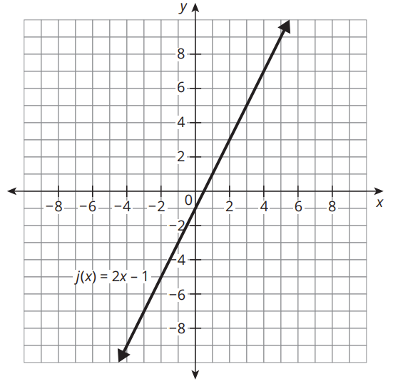
Comparing Vertical and Horizontal Translations (12 of 17)
Again, consider the graph of j(x) = 2x − 1.
  Sketch the graph of j(x) shifted right 2 units. Label the graph as b(x).
Graph b(x): through (0, −5) and (2.5, 0), slope 2
  Write an equation for b(x) in terms of j(x).
b(x) = j(x − 2)
★ Essential · SE p. 293
22
Notes:
Questions to Support Discourse – Seeing Structure:
Is q(x) written as q(x) = j(x) + 4 or written as q(x) = j(x + 4)?
Is r(x) written as r(x) = j(x) + 4 or written as r(x) = j(x + 4)?
Is b(x) written as b(x) = j(x − 2) or written as b(x) = j(x) − 2?
Is v(x) written as v(x) = j(x − 2) or written as v(x) = j(x) − 2?
For any linear function, is a vertical translation up 4 units equivalent to a horizontal translation left 4 units?
For any linear function, is a horizontal translation right 2 units equivalent to a vertical translation down 2 units?
Slide typo: the second item is labeled 'a.'; it is item b.

Slide 23
Comparing Vertical and Horizontal Translations (13 of 17)
  Sketch the graph of j(x) shifted down 2 units. Label the graph
  as v(x).
Graph v(x): through (0, −3) and (1.5, 0), slope 2
  Write an equation for v(x) in terms of j(x).
v(x) = j(x) − 2
★ Essential · SE p. 294
23
Notes:
Questions to Support Discourse – Seeing Structure:
Is q(x) written as q(x) = j(x) + 4 or written as q(x) = j(x + 4)?
Is r(x) written as r(x) = j(x) + 4 or written as r(x) = j(x + 4)?
Is b(x) written as b(x) = j(x − 2) or written as b(x) = j(x) − 2?
Is v(x) written as v(x) = j(x − 2) or written as v(x) = j(x) − 2?
For any linear function, is a vertical translation up 4 units equivalent to a horizontal translation left 4 units?
For any linear function, is a horizontal translation right 2 units equivalent to a vertical translation down 2 units?
Slide typo: both items are labeled 'a.'; they are items c and d.

Slide 24
Comparing Vertical and Horizontal Translations (14 of 17)
  Compare the graphs of b(x) and v(x). What do you notice?
  Simplify the equations for b(x) and v(x). What do you notice?
  b(x) = v(x) =
The graphs are not the same. They are parallel lines with different y-intercepts.
b(x) = j(x − 2) = 2(x − 2) − 1 = 2x − 5
v(x) = j(x) − 2 = 2x − 1 − 2 = 2x − 3
The equations for b(x) and v(x) are not the same.
★ Essential · SE p. 294
24
Notes:
Questions to Support Discourse – Seeing Structure:
Is q(x) written as q(x) = j(x) + 4 or written as q(x) = j(x + 4)?
Is r(x) written as r(x) = j(x) + 4 or written as r(x) = j(x + 4)?
Is b(x) written as b(x) = j(x − 2) or written as b(x) = j(x) − 2?
Is v(x) written as v(x) = j(x − 2) or written as v(x) = j(x) − 2?
For any linear function, is a vertical translation up 4 units equivalent to a horizontal translation left 4 units?
For any linear function, is a horizontal translation right 2 units equivalent to a vertical translation down 2 units?

Slide 25
Comparing Vertical and Horizontal Translations (15 of 17)
  For any linear function, does a horizontal translation right n units produce the same graph as a vertical translation down n units?
  For any linear function, does a horizontal translation left n units produce the same graph as a vertical translation up n units?
No. It is true only for f(x) = x. For j(x) = 2x − 1, right 2 gives 2x − 5 but down 2 gives 2x − 3.
No. For j(x) = 2x − 1, left 4 gives r(x) = 2x + 7 but up 4 gives q(x) = 2x + 3.
★ Essential · SE p. 294
25
Notes:
Questions to Support Discourse – Seeing Structure:
Is q(x) written as q(x) = j(x) + 4 or written as q(x) = j(x + 4)?
Is r(x) written as r(x) = j(x) + 4 or written as r(x) = j(x + 4)?
Is b(x) written as b(x) = j(x − 2) or written as b(x) = j(x) − 2?
Is v(x) written as v(x) = j(x − 2) or written as v(x) = j(x) − 2?
For any linear function, is a vertical translation up 4 units equivalent to a horizontal translation left 4 units?
For any linear function, is a horizontal translation right 2 units equivalent to a vertical translation down 2 units?

Slide 26
Comparing Vertical and Horizontal Translations (16 of 17)
Let’s revisit the Essential Question and summarize our learning from Activity 2.1!
Essential Question: What effect do horizontal transformations have on linear functions? How do they compare to vertical transformations?
★ Essential · SE p. 294
26
Notes:
Note: To close Day 1, have students reread the Essential Question and then read the Stamp the Learning summary aloud.
Activity 2.1 Summary:
For the parent function f(x) = x, a horizontal translation right n units produces the same graph as a vertical translation down n units. In addition, a horizontal translation left n units produces the same graph as a vertical translation up n units.

Slide 27
Comparing Vertical and Horizontal Translations (17 of 17)
★ Essential · SE p. 294
27
Notes:
Note: This slide is blank for optional use with displaying work.

Slide 28
Day 2
2
28
Notes:
Note: Total suggested pacing for Day 2 is 45 minutes.

Slide 29
Essential Question (2 of 2)
What effect do horizontal transformations have on linear functions? How do they compare to vertical transformations?
When f(x) is replaced by a·f(b(x − c)) + d, b and c affect the input values (horizontal transformations), while a and d affect the output values (vertical transformations).
For f(x) = x, a translation right n gives the same graph as a translation down n, and a horizontal dilation by n gives the same graph as a vertical dilation by 1/n. For other linear functions these pairs are not the same.
SE p. 287
29
Notes:
Note: To begin Day 2, have a student read the Essential Question aloud.

Slide 30
Activity 2.2
★ Essential activity: do not skip
2.2
15–20
30
Notes:
Note: Total time of 15-20 minutes allotted for Activity 2.2.

Slide 31
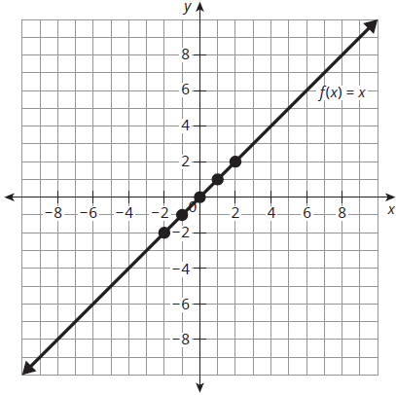
Comparing Vertical and Horizontal Dilations (1 of 13)
The graph and a table of values for f(x) = x are provided for you.
  Sketch the graph of a(x), if the output values of a(x) are changed by a factor of 2. Complete the table of corresponding points on a(x).
Original Graph
Transformed Graph
x | f(x)
−2 | −2
−1 | −1
0 | 0
1 | 1
2 | 2
x | a(x)
−2
−1
0
1
2
−4
Graph a(x): through (0, 0) and (1, 2)
−2
0
2
4
★ Essential · SE p. 295
31
Notes:
Questions to Support Discourse – Probing:
How do you change the output values of a(x) by a factor of 2?
How do you change the input values of b(x) by a factor of $\frac{1}{2}$?
How do you change the output values of c(x) by a factor of $\frac{4}{5}$?
How do you change the input values of d(x) by a factor of $\frac{5}{4}$?

Slide 32
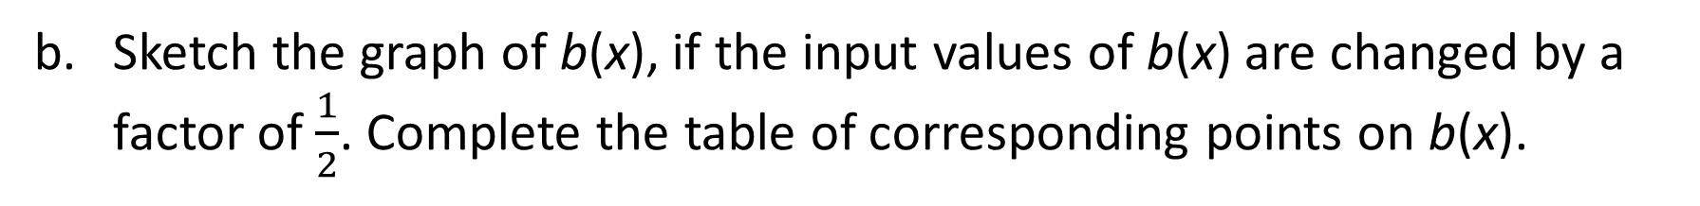
Comparing Vertical and Horizontal Dilations (2 of 13)
  Sketch the graph of b(x), if the input values of b(x) are changed by a factor of $\frac{1}{2}$. Complete the table of corresponding points on b(x).
Original Graph
Transformed Graph
x | f(x)
−2 | −2
−1 | −1
0 | 0
1 | 1
2 | 2
x | b(x)
 | −2
 | −1
 | 0
 | 1
 | 2
−1
Graph b(x): through (0, 0) and (1, 2), the same line as a(x)
−1/2
0
1/2
1
★ Essential · SE p. 295
32
Notes:
Questions to Support Discourse – Probing:
How do you change the output values of a(x) by a factor of 2?
How do you change the input values of b(x) by a factor of $\frac{1}{2}$?
How do you change the output values of c(x) by a factor of $\frac{4}{5}$?
How do you change the input values of d(x) by a factor of $\frac{5}{4}$?

Slide 33
Comparing Vertical and Horizontal Dilations (3 of 13)
  Compare the graphs and tables of values for a(x) and b(x). What do you notice?
The graphs of a(x) and b(x) are the same line, y = 2x, but their tables of values are different.
★ Essential · SE p. 295
33
Notes:
Questions to Support Discourse – Probing:
How do you change the output values of a(x) by a factor of 2?
How do you change the input values of b(x) by a factor of $\frac{1}{2}$?
How do you change the output values of c(x) by a factor of $\frac{4}{5}$?
How do you change the input values of d(x) by a factor of $\frac{5}{4}$?

Slide 34
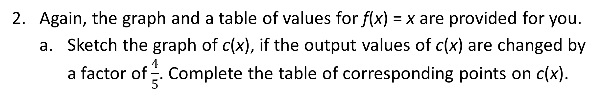
Comparing Vertical and Horizontal Dilations (4 of 13)
Again, the graph and a table of values for f(x) = x are provided for you.
  Sketch the graph of c(x), if the output values of c(x) are changed by a factor of $\frac{4}{5}$. Complete the table of corresponding points on c(x).
Original Graph
Transformed Graph
x | f(x)
−2 | −2
−1 | −1
0 | 0
1 | 1
2 | 2
x | c(x)
−2
−1
0
1
2
−8/5
Graph c(x): through (0, 0) and (5, 4)
−4/5
0
4/5
8/5
★ Essential · SE p. 295
34
Notes:
Questions to Support Discourse – Probing:
How do you change the output values of a(x) by a factor of 2?
How do you change the input values of b(x) by a factor of $\frac{1}{2}$?
How do you change the output values of c(x) by a factor of $\frac{4}{5}$?
How do you change the input values of d(x) by a factor of $\frac{5}{4}$?

Slide 35
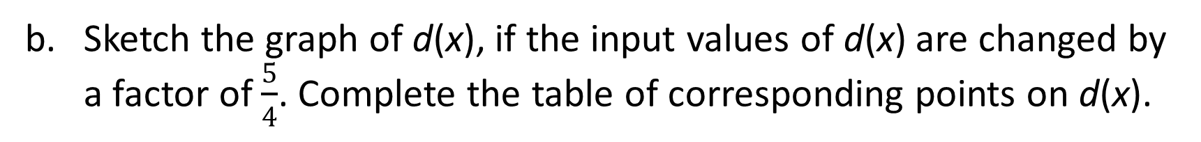
Comparing Vertical and Horizontal Dilations (5 of 13)
Sketch the graph of d(x), if the input values of d(x) are changed by a factor of $\frac{5}{4}$. Complete the table of corresponding points on d(x).
Original Graph
Transformed Graph
x | f(x)
−2 | −2
−1 | −1
0 | 0
1 | 1
2 | 2
x | d(x)
 | −2
 | −1
 | 0
 | 1
 | 2
−5/2
Graph d(x): through (0, 0) and (5, 4), the same line as c(x)
−5/4
0
5/4
5/2
★ Essential · SE p. 295
35
Notes:
Questions to Support Discourse – Probing:
How do you change the output values of a(x) by a factor of 2?
How do you change the input values of b(x) by a factor of $\frac{1}{2}$?
How do you change the output values of c(x) by a factor of $\frac{4}{5}$?
How do you change the input values of d(x) by a factor of $\frac{5}{4}$?

Slide 36
Comparing Vertical and Horizontal Dilations (6 of 13)
  Compare the graphs and tables of values for c(x) and d(x). What do you notice?
The graphs of c(x) and d(x) are the same line, y = (4/5)x, but their tables of values are different.
★ Essential · SE p. 295
36
Notes:
Questions to Support Discourse – Probing:
How do you change the output values of a(x) by a factor of 2?
How do you change the input values of b(x) by a factor of $\frac{1}{2}$?
How do you change the output values of c(x) by a factor of $\frac{4}{5}$?
How do you change the input values of d(x) by a factor of $\frac{5}{4}$?

Slide 37
Comparing Vertical and Horizontal Dilations (7 of 13)
Based on your observations, changing the output values of the parent function f(x) = x by a factor of n units is equivalent to changing the input values by what factor?
Based on your observations, changing the input values of the parent function f(x) = x by a factor of n units is equivalent to changing the output values by what factor?
A factor of 1/n.
A factor of 1/n.
★ Essential · SE p. 296
37
Notes:
Questions to Support Discourse – Probing:
How do you change the output values of a(x) by a factor of 2?
How do you change the input values of b(x) by a factor of $\frac{1}{2}$?
How do you change the output values of c(x) by a factor of $\frac{4}{5}$?
How do you change the input values of d(x) by a factor of $\frac{5}{4}$?

Slide 38
Comparing Vertical and Horizontal Dilations (8 of 13)
For the parent function f(x) = x, the transformed function y = af(x) affects the output values, or y-values, of the function. For |a| > 1, the resulting graph vertically stretches by a factor of a units. For 0 < |a| < 1, the resulting graph vertically compresses by a factor of a units. For a < 0, the resulting graph reflects across the x-axis.
★ Essential · SE p. 297
38

Slide 39
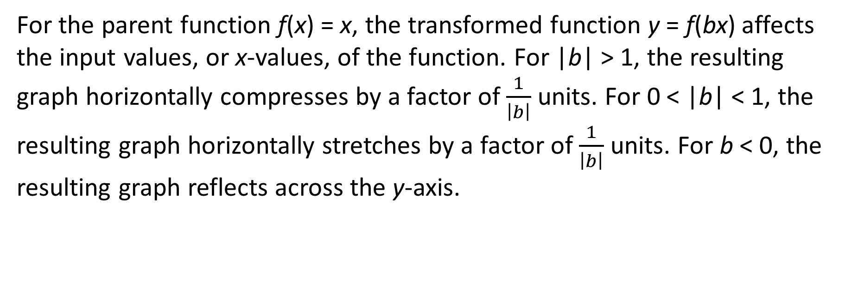
Comparing Vertical and Horizontal Dilations (9 of 13)
For the parent function f(x) = x, the transformed function y = f(bx) affects the input values, or x-values, of the function. For |b| > 1, the resulting graph horizontally compresses by a factor of $\frac{1}{\left|b\right|}$ units. For 0 < |b| < 1, the resulting graph horizontally stretches by a factor of $\frac{1}{\left|b\right|}$ units. For b < 0, the resulting graph reflects across the y-axis.
★ Essential · SE p. 297
39

Slide 40
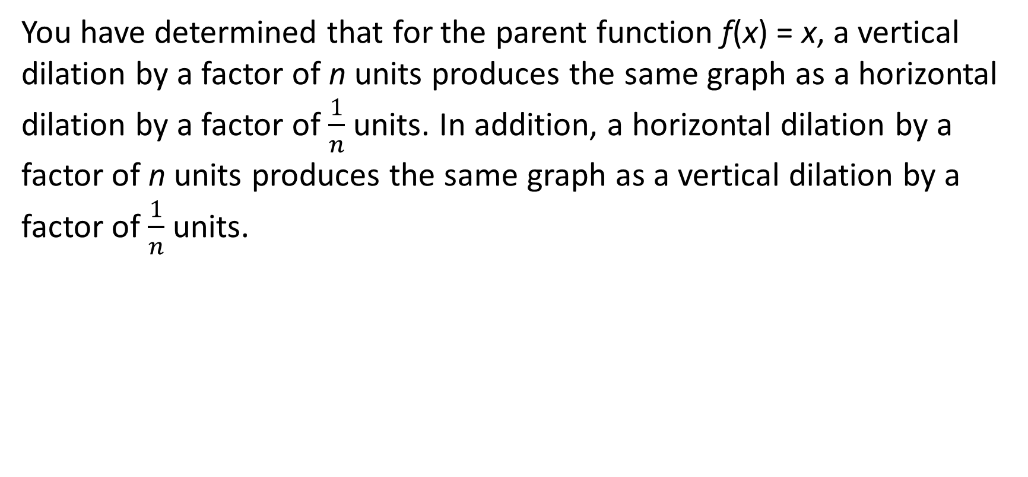
Comparing Vertical and Horizontal Dilations (10 of 13)
You have determined that for the parent function f(x) = x, a vertical dilation by a factor of n units produces the same graph as a horizontal dilation by a factor of $\frac{1}{n}$ units. In addition, a horizontal dilation by a factor of n units produces the same graph as a vertical dilation by a factor of $\frac{1}{n}$ ​units.
★ Essential · SE p. 297
40

Slide 41
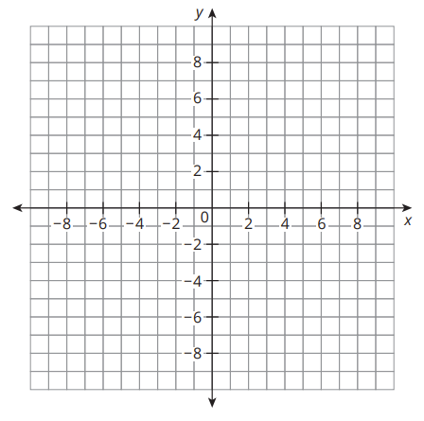
Comparing Vertical and Horizontal Dilations (11 of 13)
Does this relationship between horizontal and vertical dilations hold true for any linear function? Explain your reasoning. Provide a counterexample if necessary.
No. It is true only for the parent function f(x) = x.
Counterexample: m(x) = 2x − 1.
n(x) = 3·m(x) = 3(2x − 1) = 6x − 3
p(x) = m(3x) = 2(3x) − 1 = 6x − 1
The graphs of n(x) and p(x) are parallel, not the same.
Graph: m(x) through (0, −1), slope 2; n(x) through (0, −3) and p(x) through (0, −1), slope 6.
★ Essential · SE p. 297
41
Notes:
Questions to Support Discourse – Probing:
Does this relationship between horizontal and vertical dilations hold true for all linear functions with a slope of 1?
Does this relationship between horizontal and vertical dilations hold true for all linear functions with a y-intercept of 0?
Does your counterexample include graphs, equations, or both?
Counterexamples will vary: any linear function other than f(x) = x works, as long as students compare n·m(x) with m(nx).

Slide 42
Comparing Vertical and Horizontal Dilations (12 of 13)
Let’s summarize our learning from Activity 2.2!
★ Essential · SE p. 297
42
Notes:
Activity 2.2 Summary:
For the parent function f(x) = x, changing the output values by a factor of n units is equivalent to changing the input values by a factor of $\frac{1}{n}$ units. This relationship between horizontal and vertical dilations is only true for the parent function f(x) = x.

Slide 43
Comparing Vertical and Horizontal Dilations (13 of 13)
★ Essential · SE p. 297
43
Notes:
Note: This slide is blank for optional use with displaying work.

Slide 44
Activity 2.3
★ Essential activity: do not skip
2.3
15–20
44
Notes:
Note: Total time of 15-20 minutes allotted for Activity 2.3.

Slide 45
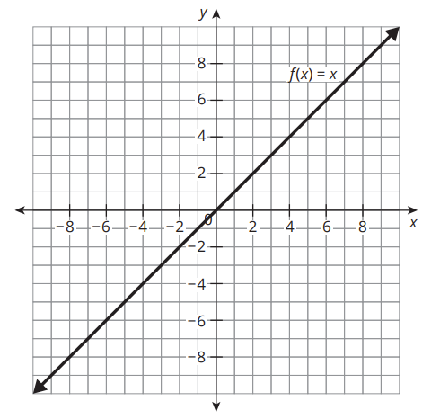
Graphing Linear Transformations (1 of 8)
The equation of the parent linear function f(x) is given. The equation for the transformed function g(x) is also given. Describe the transformation(s) performed on f(x) to produce g(x). Then, graph g(x).
f(x) = x
g(x) = f(x − 7)
f(x) is translated right 7 units.
Graph g(x) = x − 7: through (7, 0) and (0, −7)
★ Essential · SE p. 298
45
Notes:
Questions to Support Discourse – Gathering:
Is the transformed function g(x) translated horizontally? If so, by how many units?
Is the transformed function g(x) translated vertically? If so, by how many units?
Is the transformed function g(x) dilated horizontally? If so, by what factor?
Is the transformed function g(x) dilated vertically? If so, by what factor?

Slide 46
Graphing Linear Transformations (2 of 8)
f(x) = x
g(x) = 3f(x)
f(x) is stretched vertically by a factor of 3.
Graph g(x) = 3x: through (0, 0) and (2, 6)
★ Essential · SE p. 298
46
Notes:
Questions to Support Discourse – Gathering:
Is the transformed function g(x) translated horizontally? If so, by how many units?
Is the transformed function g(x) translated vertically? If so, by how many units?
Is the transformed function g(x) dilated horizontally? If so, by what factor?
Is the transformed function g(x) dilated vertically? If so, by what factor?
Slide typo: slides 46, 47, 49 and 50 number their item '1.'; they are items 2, 3, 5 and 6.

Slide 47
Graphing Linear Transformations (3 of 8)
f(x) = x
g(x) = f(x) + 2
f(x) is translated up 2 units.
Graph g(x) = x + 2: through (0, 2) and (−2, 0)
★ Essential · SE p. 299
47
Notes:
Questions to Support Discourse – Gathering:
Is the transformed function g(x) translated horizontally? If so, by how many units?
Is the transformed function g(x) translated vertically? If so, by how many units?
Is the transformed function g(x) dilated horizontally? If so, by what factor?
Is the transformed function g(x) dilated vertically? If so, by what factor?

Slide 48
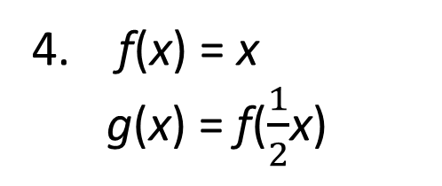
Graphing Linear Transformations (4 of 8)
f(x) = x
g(x) = f($\frac{1}{2}$x)
f(x) is stretched horizontally by a factor of 2.
Graph g(x) = (1/2)x: through (0, 0) and (4, 2)
★ Essential · SE p. 299
48
Notes:
Questions to Support Discourse – Gathering:
Is the transformed function g(x) translated horizontally? If so, by how many units?
Is the transformed function g(x) translated vertically? If so, by how many units?
Is the transformed function g(x) dilated horizontally? If so, by what factor?
Is the transformed function g(x) dilated vertically? If so, by what factor?

Slide 49
Graphing Linear Transformations (5 of 8)
f(x) = x
g(x) = f(x) − 4
f(x) is translated down 4 units.
Graph g(x) = x − 4: through (0, −4) and (4, 0)
★ Essential · SE p. 300
49
Notes:
Questions to Support Discourse – Gathering:
Is the transformed function g(x) translated horizontally? If so, by how many units?
Is the transformed function g(x) translated vertically? If so, by how many units?
Is the transformed function g(x) dilated horizontally? If so, by what factor?
Is the transformed function g(x) dilated vertically? If so, by what factor?

Slide 50
Graphing Linear Transformations (6 of 8)
f(x) = x
g(x) = f(x + 5)
f(x) is translated left 5 units.
Graph g(x) = x + 5: through (0, 5) and (−5, 0)
★ Essential · SE p. 300
50
Notes:
Questions to Support Discourse – Gathering:
Is the transformed function g(x) translated horizontally? If so, by how many units?
Is the transformed function g(x) translated vertically? If so, by how many units?
Is the transformed function g(x) dilated horizontally? If so, by what factor?
Is the transformed function g(x) dilated vertically? If so, by what factor?

Slide 51
Graphing Linear Transformations (7 of 8)
Let’s summarize our learning from Activity 2.3!
★ Essential · SE p. 300
51
Notes:
Activity 2.3 Summary:
Changing the output values of the parent function f(x) = x, affects the graph of the function vertically. Changes to the input values of the parent function f(x) = x, affects the graph of the function horizontally.

Slide 52
Graphing Linear Transformations (8 of 8)
★ Essential · SE p. 300
52
Notes:
Note: This slide is blank for optional use with displaying work.

Slide 53
Talk the Talk
5
53
Notes:
Note: Total time of 5 minutes allotted for the Talk the Talk.

Slide 54
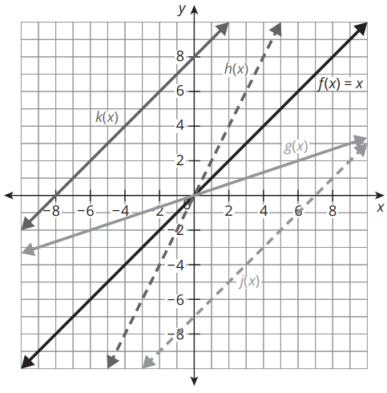
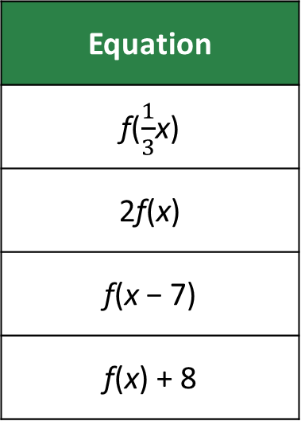
Show Me What You’ve Got! (1 of 4)
The graph shows the linear function f(x) = x and four transformations of f(x).
Equation
f($\frac{1}{3}$x)
2f(x)
f(x − 7)
f(x) + 8
SE p. 301
54

Slide 55
Show Me What You’ve Got! (2 of 4)
Match each transformed graph to the equation in the table, written in terms of f(x).
k(x) = ___________________
h(x) = ___________________
g(x) = ___________________
j(x) = ____________________
f(x) + 8
2f(x)
f((1/3)x)
f(x − 7)
SE p. 301
55
Notes:
Questions to Support Discourse – Reflecting and Justifying:
Which function equations affect the input values?
Which function equations affect the output values?
How do horizontal transformations affect the graph of the parent function f(x)?

Slide 56
Show Me What You’ve Got! (3 of 4)
Let’s answer the Essential Question and summarize our learning from the Talk the Talk!
Essential Question: What effect do horizontal transformations have on linear functions? How do they compare to vertical transformations?
SE p. 301
56
Notes:
Note: To close Day 2, have students read and answer the Essential Question and then read the Stamp the Learning summary aloud.
Essential Question:
Sample answer: When f(x) is replaced by af(b(x − c)) + d, b- and c- affect the input values of the function where as a- and d- affect the output values of the function.
Talk the Talk Summary:
Horizontal transformations of linear functions are caused by changes to the x-values, and vertical transformations of linear functions are caused by changes to the y-values.

Slide 57
Show Me What You’ve Got! (4 of 4)
SE p. 301
57
Notes:
Note: This slide is blank for optional use with displaying work.

Slide 58
Teacher Edition corrections in this deck
• Prepare Q2: the TE gives the reciprocal of −10 as 1/10; it is −1/10.
• Slide typos: slide 22's second item 'a.' is b; slide 23's two 'a.' items are c and d; slides 46, 47, 49 and 50 are items 2, 3, 5 and 6, not '1.'
• Every other TE answer was re-solved and is correct.
58

Slide 59
Prepare
59
Notes:
How can you identify whether students are ready for new learning? ​
Depending on available time, you can assign the Prepare section of the Lesson Assignments as homework or as a warm-up to identify students' prior knowledge for the upcoming lesson's activities.

Slide 60
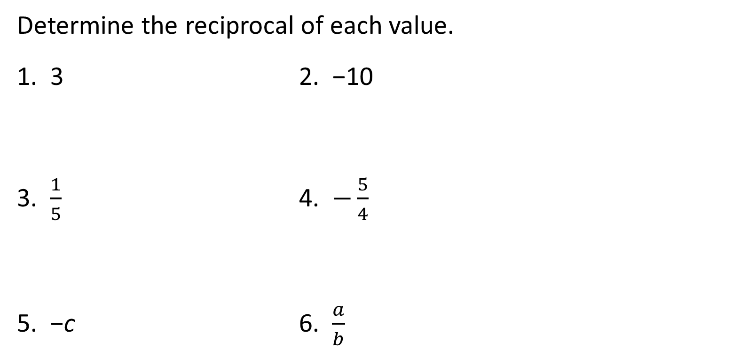
Prepare for Module 2 Topic 2 Lesson 3
Determine the reciprocal of each value.
1. 3 2. −10
3. $\frac{1}{5}$ 4. $−\frac{5}{4}$
5. −c 6. $\frac{a}{b}$
1/3
−1/10
5
−4/5
−1/c
b/a
SE p. 304
60
Notes:
TE correction: the TE prints the reciprocal of −10 as 1/10. It is −1/10, since (−10)(−1/10) = 1.

Slide 61
Acknowledgment and Notice
61

Slide 62
BLMATH_AlgI_M2_T2_L2_DCS_ENG
62

